Slide 1
GROUP 24 SIMULATED SWARM GOLD TEAM
Sponsor: Joseph Rivera – Lockheed Martin

Slide 2
OUR
Members
R
O
L
E
S
James Murphy
Matthew Hubbs
Bobby Pappas
Project Manager
(Lead) Object Detection
(Lead) Simulated Environment
Object Detection
Simulated Environment
Object Detection
Andrew Borg
Sebastian Almeida
(Lead) Pathfinding and Mapping
Swarm
(Lead) Swarm
Pathfinding and Mapping

Slide 3
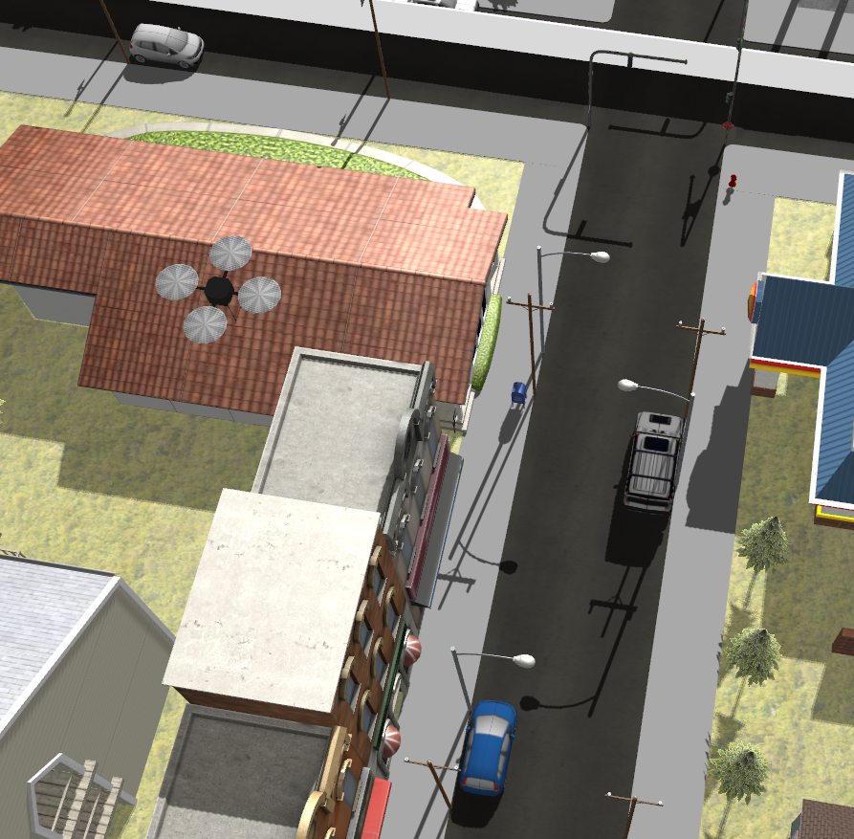
OUR
Task
Produce a Simulated Swarm of 4-5 Drones using ROS (Robot Operating System)
Use a Deep Learning Object Detection Model to identify a Target robot
Use Pathfinding and Mapping Technology to navigate a 400ft x 400ft unknown urban environment to locate said Target robot in Three Minutes

Slide 4
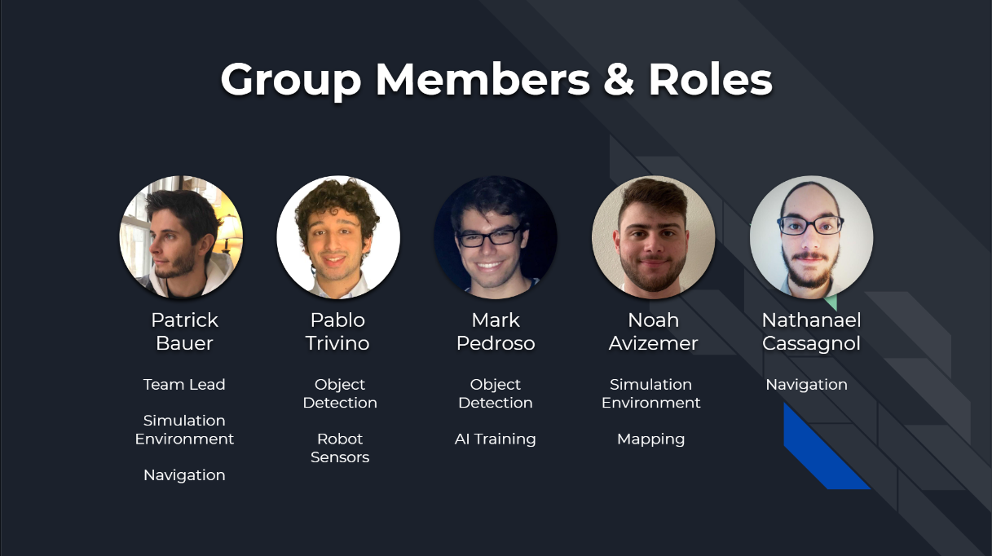
PREVIOUS PROJECT
Their Task:
Similar to ours, with a few differences
They had to create their own Simulated Environment from scratch
They had to implement a Ground Robot and a Drone
Same Goal

Slide 5
THEN WHY US?
They only managed to implement a TurtleBot, no drone(s)
Technology, Motives, and Algorithms have changed rapidly since their implementation
Lockheed still wants CS students to have the opportunity to work on the latest simulation technology, robotics, and Deep/Machine Learning topics.
To showcase a Swarm Approach for the previous task

Slide 6










OUR TECHNOLOGIES

Slide 7
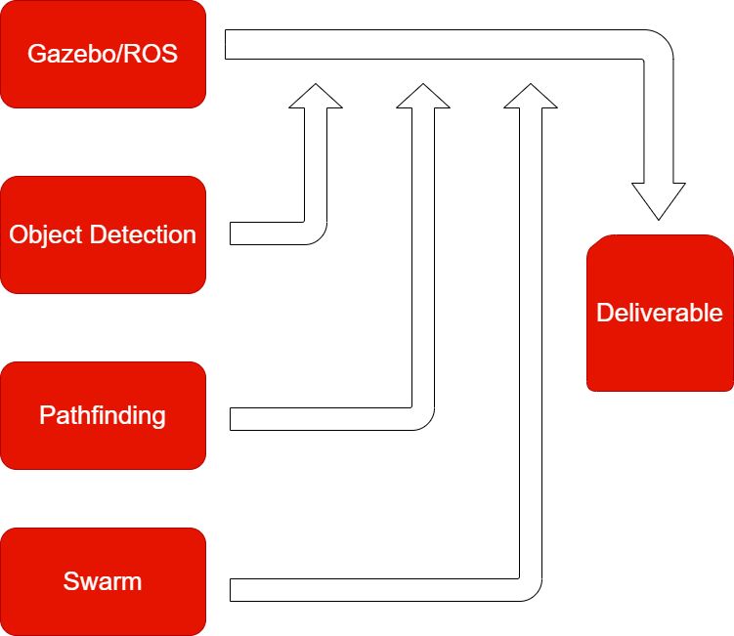
OUR APPROACH PHILOSOPHY

Slide 8



STAGES OF PRODUCTION
Trial Examples:
- Camera Tilt
- Drone Speeds
- Drone Count
Stage 1 - Research​
Stage 2 - Development​
Stage 3 - Trials
We look into all aspects and tools required for our project. Gain the skillset and mastery for efficient and effective development.
We implement our acquired knowledge and implement all tools for a working, base level, deliverable
We begin improving the deliverable’s efficiency with small variable based changes.

Slide 9
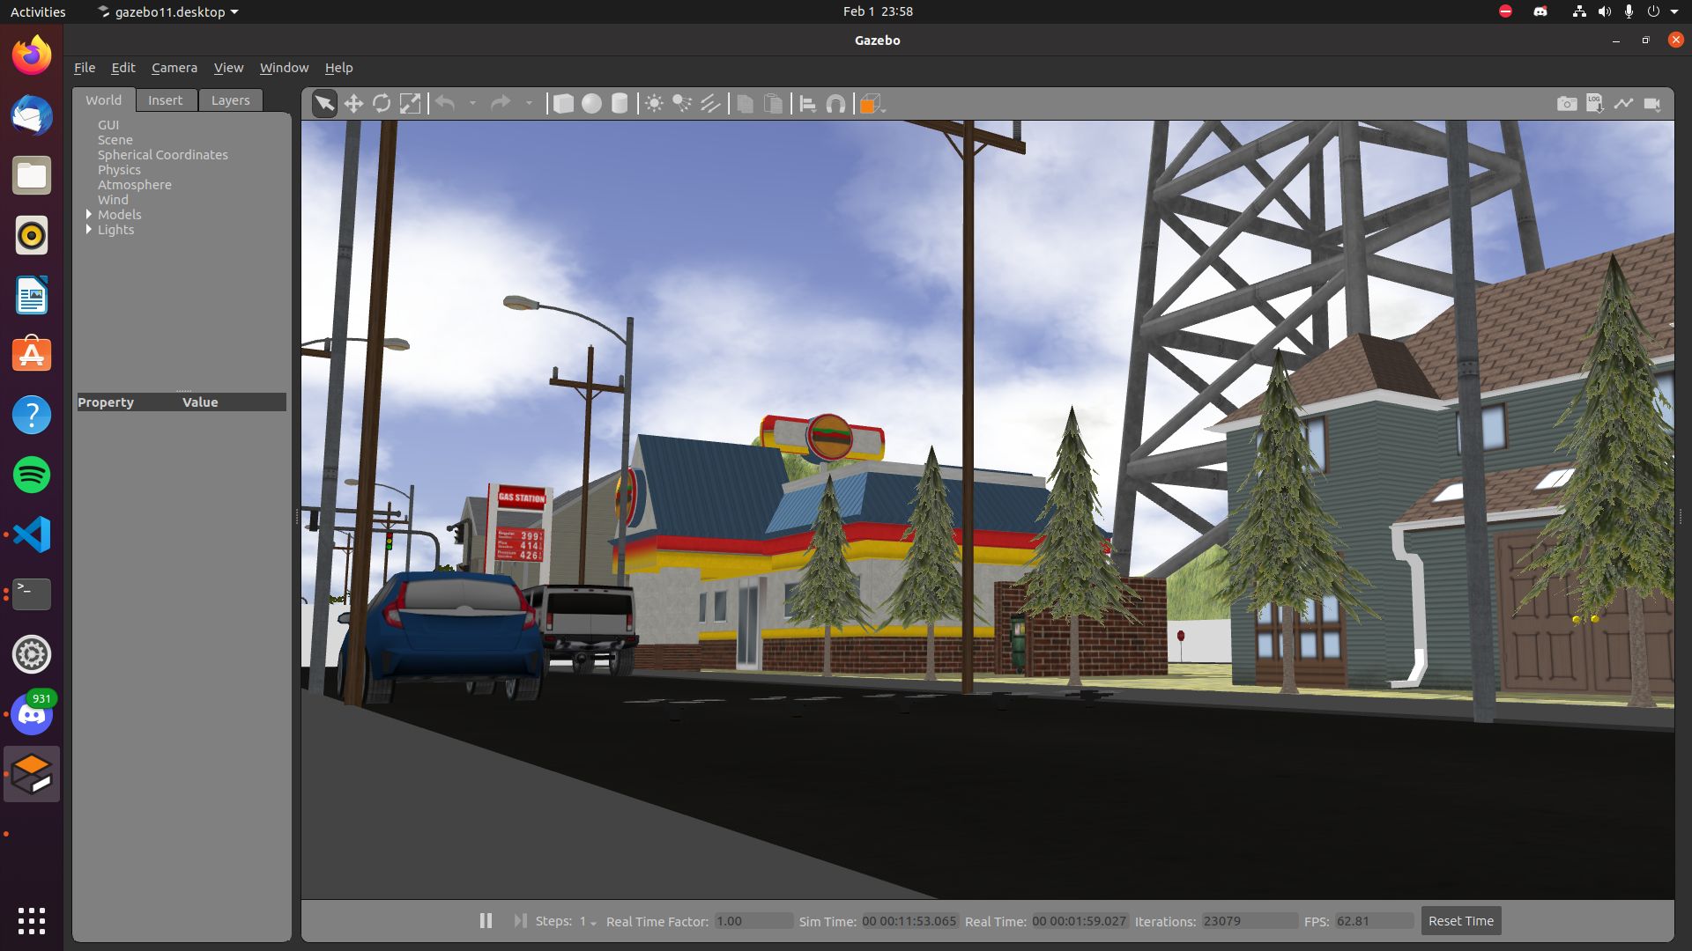
GAZEBO VOCABULARY
.launch file type
Spawns and generates Models/Worlds
.world file type
The Simulated Environment
.urdf/.xacro files types
Model files
rostopic
A data-stream that is Published/Subscribed to by ROS

Slide 10
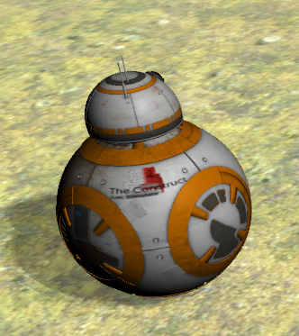
GAZEBO MODELS
What we inherited:
Previous team’s urban environment (.world)
Previous team’s target (BB-8 model)
What we needed to implement:
Gazebo/ROS Workspace
4 – 5 Drones
A Camera (for Object Detection)
LIDAR (for Mapping, Pathfinding)

Slide 11
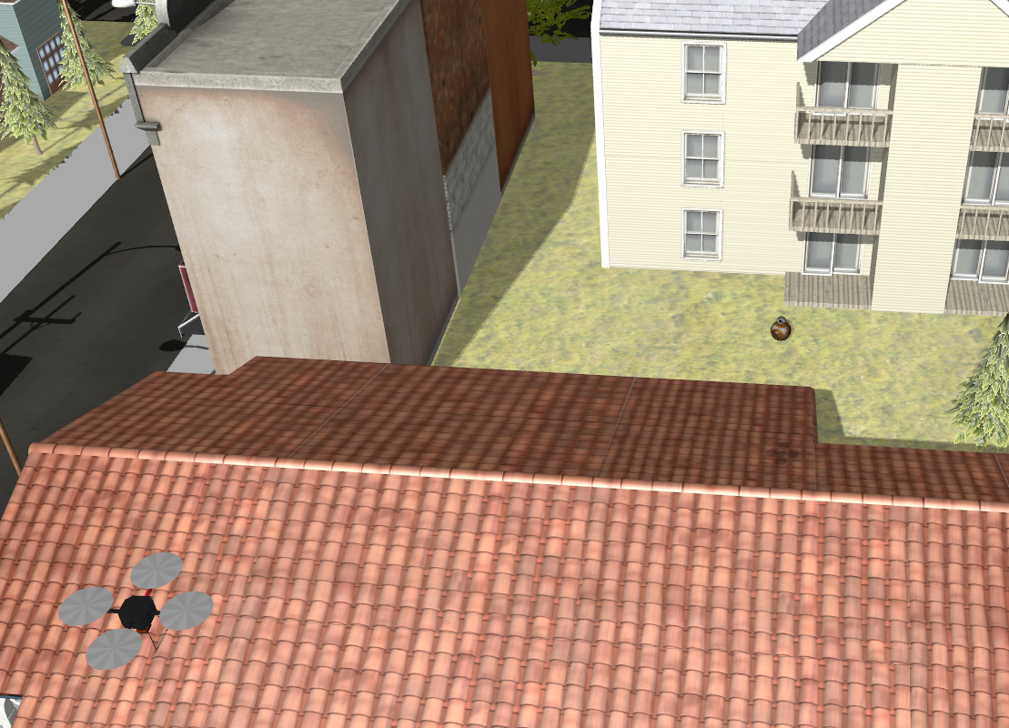
GAZEBO DEVELOPMENT
LAUNCH FILES CREATED FOR MODELS
only_world.launch
only_bb8.launch
put_robot_in_world.launch
spawn_five_quadrotors.launch

Slide 12
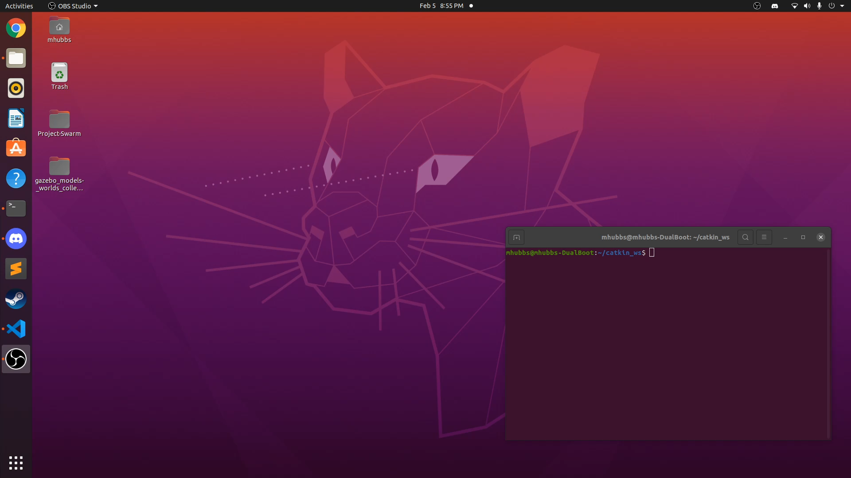
ONLY_WORLD.LAUNCH
Generates the urban environment .world file

Slide 13
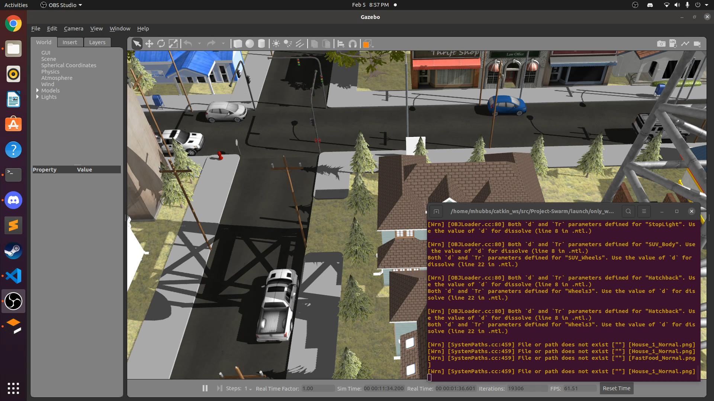
ONLY_BB8.LAUNCH
Generates the bb8 .urdf, .xacro, and meshes

Slide 14
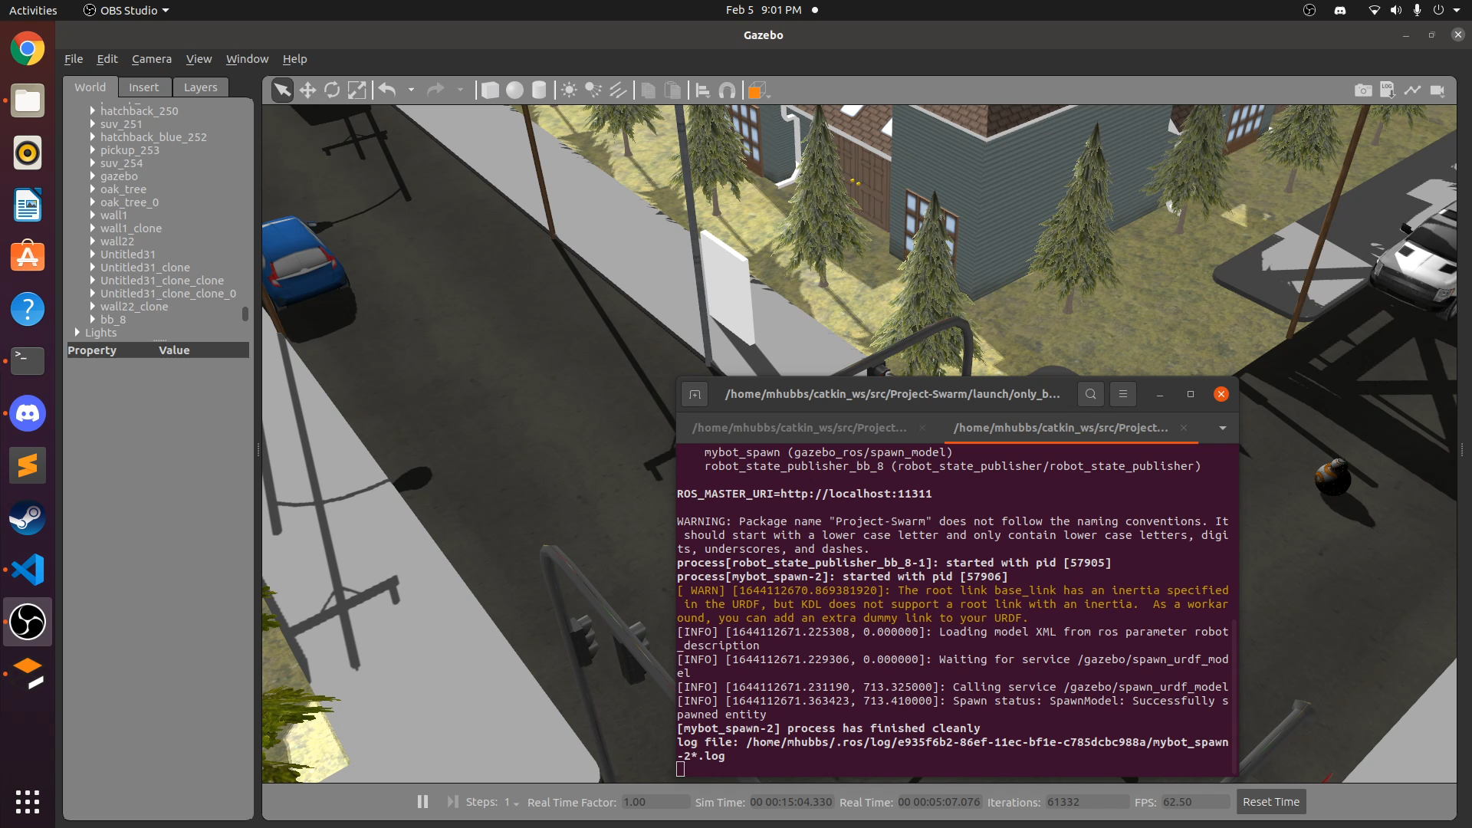
PUT_ROBOT_IN_WORLD.LAUNCH
Generates a single Hector Quadrotor with camera and LIDAR plugins

Slide 15
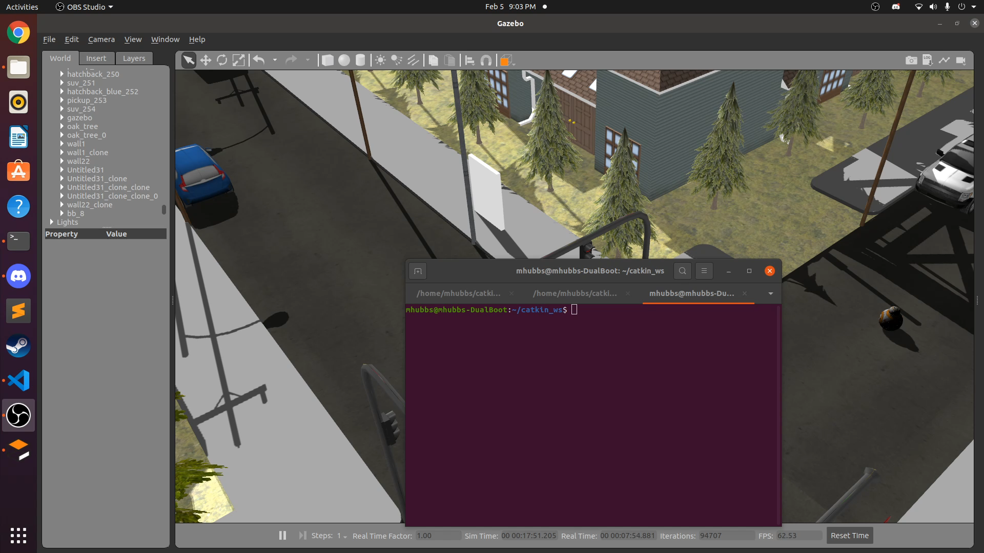
SPAWN_FIVE_QUADROTORS.LAUNCH
Generates Five Hector Quadrotors with cameras and LIDAR plugins

Slide 16
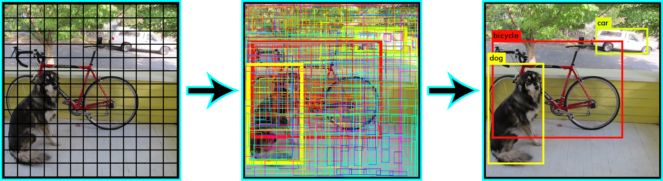
OBJECT DETECTION
What the Previous Team implemented
YOLOv3
What Our Team implemented:
YOLOv5

Slide 17
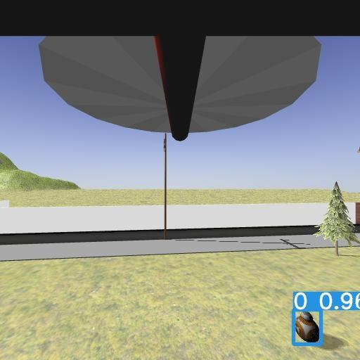
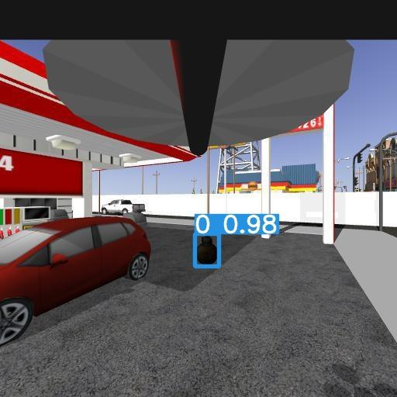
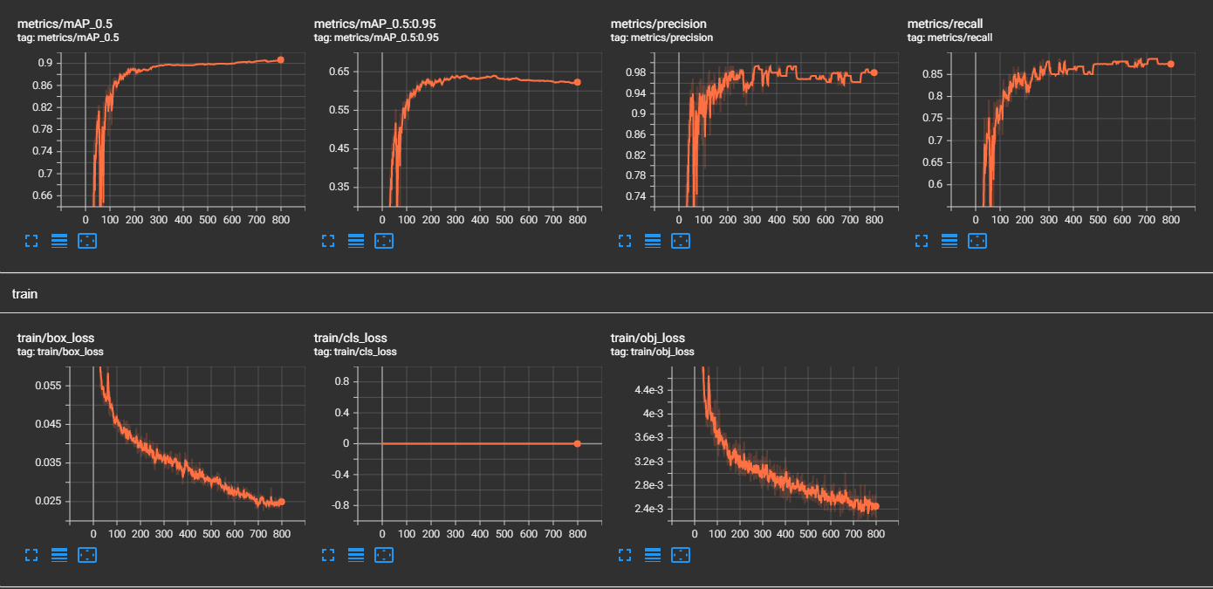
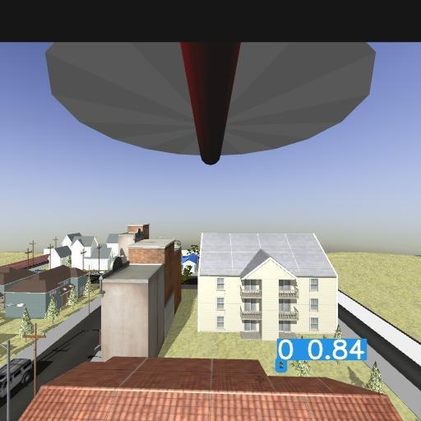
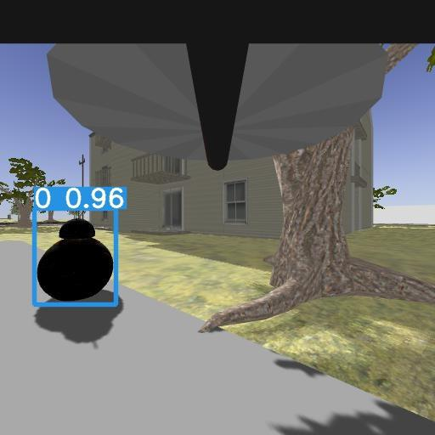
OUR BEST MODEL: V4

Slide 18
TRAINING PROCESS
* = Best Model
V1
V2
V3
V4*
The Starting Point
We have something to start with
Handful of False Positives
Not enough True Negatives in our dataset
Small Dataset
No Augmentation
Small Epochs
A Proper Starting Point
We got a base, now lets make this better
Less False Positives
Added More True Negatives
Larger Dataset
Roboflow Augmentation
Appropriate Epochs
Improving Edge Cases
Added to the dataset to deal with harder inputs
New False Positives
Too much generalization
Larger Dataset
Roboflow Augmentation
Appropriate Epochs
Hyperparameters
We took advice from our sponsor and tuned our hyperparameters
Much Less False Positives
Larger Dataset
Roboflow Augmentation and YOLOv5 hyperparameters
Appropriate Epochs

Slide 19
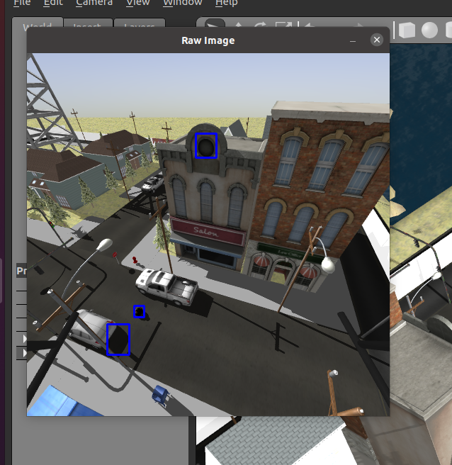
V5 AND V6
Generalization problems returned
Tried different Hyperparameter values, didn’t work out
Recall improved but at the cost of precision.
V5 was producing too many False Positives
V6 was ran on less epochs, resulted in a poor model overall

Slide 20
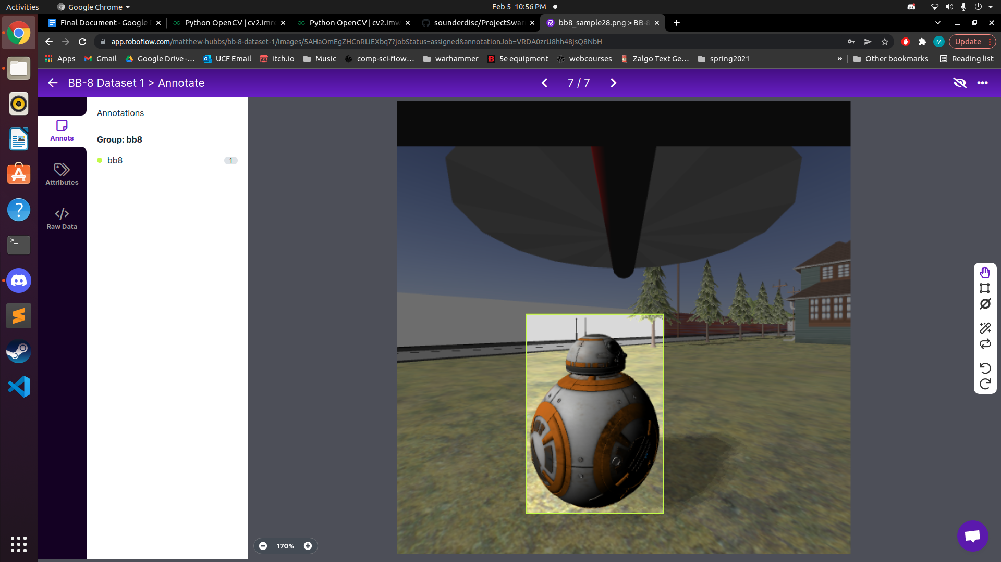
DATA ANNOTATION
Roboflow – A Free Image Annotation website (labelling)
Roboflow Provides:
User Friendly UI for Labelling (Point and Click)
Quick navigation between images
Easy data-splitting (75:10:15)
Built-In Image Augmentation
Easy Export into YOLOv5
Jupyter Notebook for Training

Slide 21
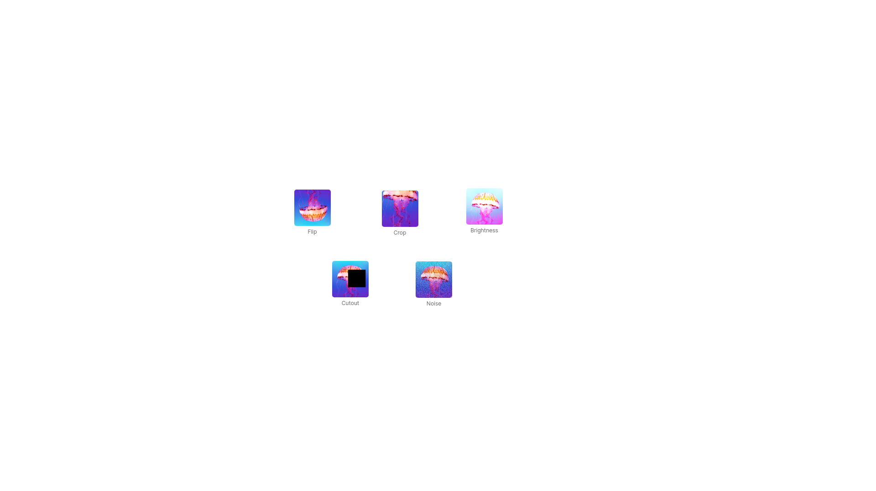
Data Augmentation
Random Augmentation = 3 per image
Augmentation Table:
Flip – over X (in case drone crashes upside down)
Crop – cut off parts of the Image (simulate peaking around corner)
Brightness (Time of Day, Different GPU Drivers)
Cutout – inserts random [:, :, 0] dimensions over image (simulate cover)
Noise – Salt and Pepper Filter (lost frames, lag)

Slide 22
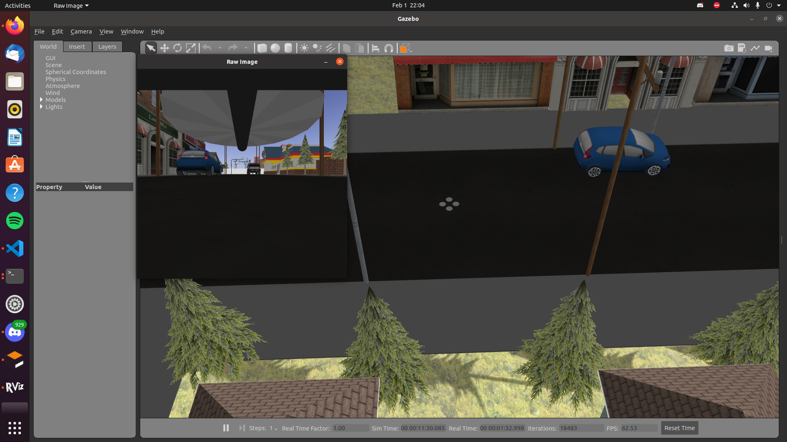
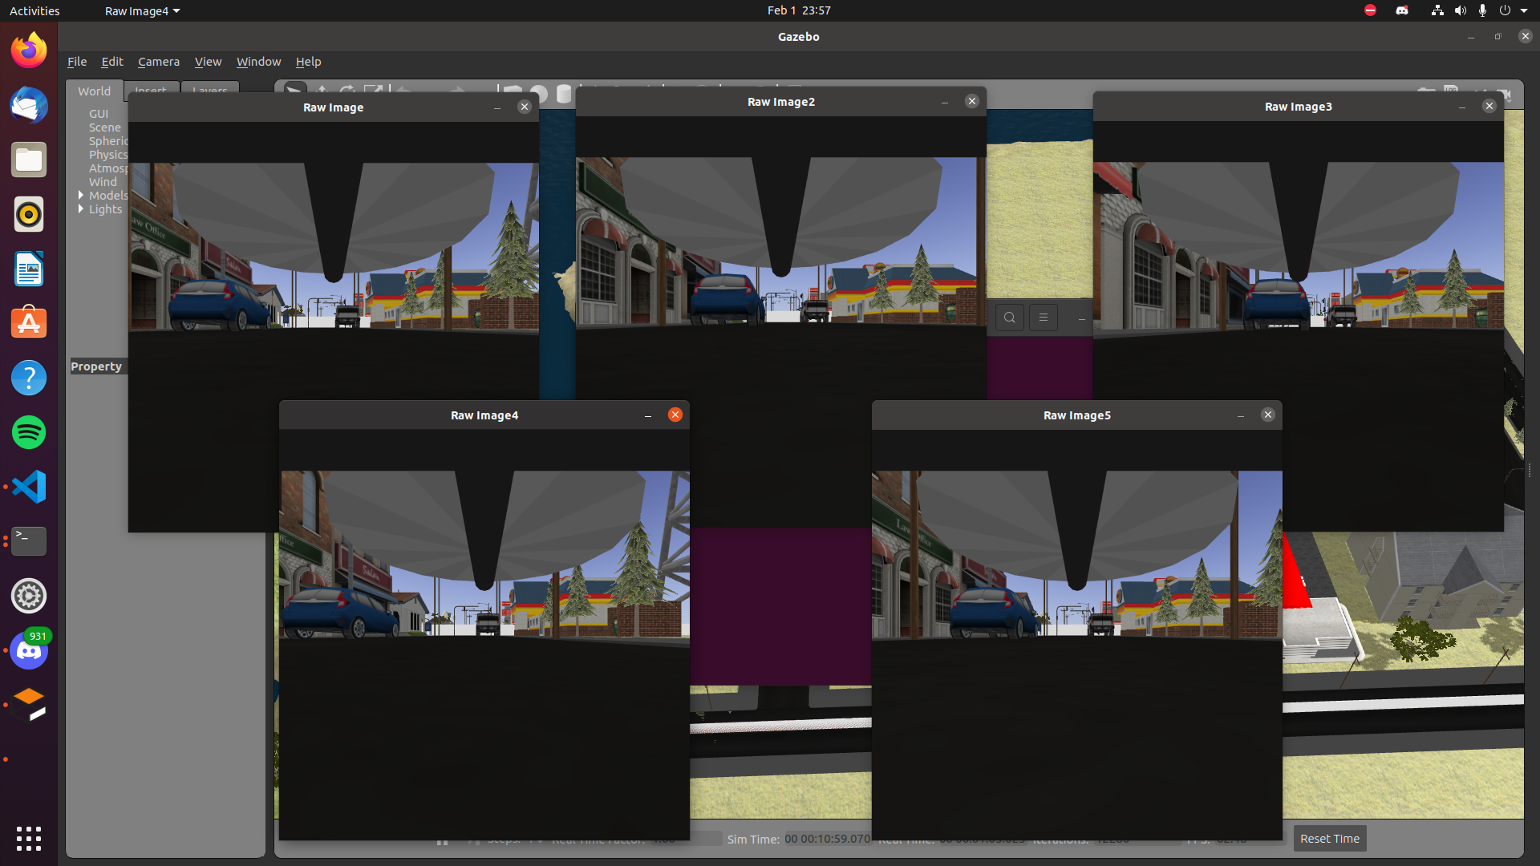
OPENCV-CAMERA.PY
Put_robot_in_world.launch
(1 drone)
Spawn_five_quadrotors.launch
(5 drones)

Slide 23
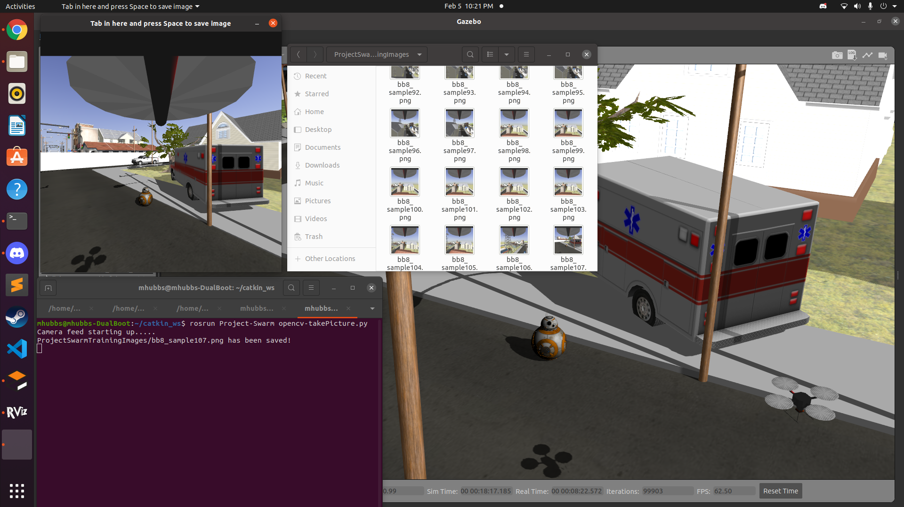
OPENCV-TAKEPICTURE.PY
rosrun Project-Swarm opencv-takePicure.py

Slide 24
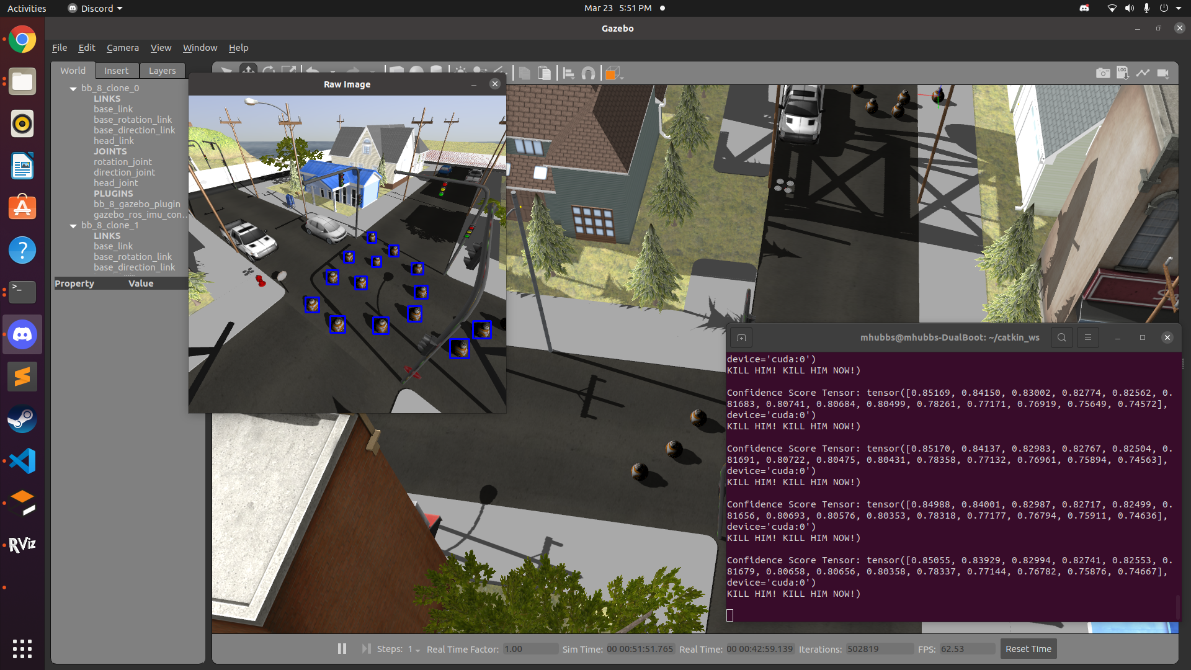
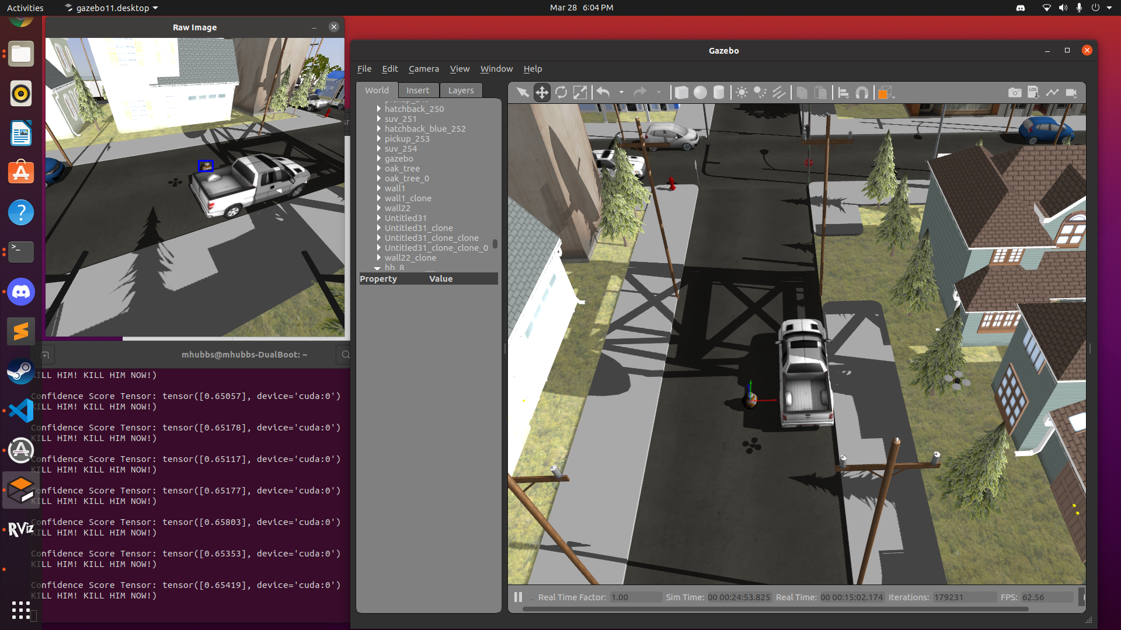
STRENGTHS OF THE V4 MODEL

Slide 25
Mapping, Pathfinding, AI
(oh my)
3 primary steps
Determine where the drone is in the world, and what the world looks like
Explore the world by seeking out areas that have not been seen yet
Plan out paths that can accomplish exploration without collisions

Slide 26
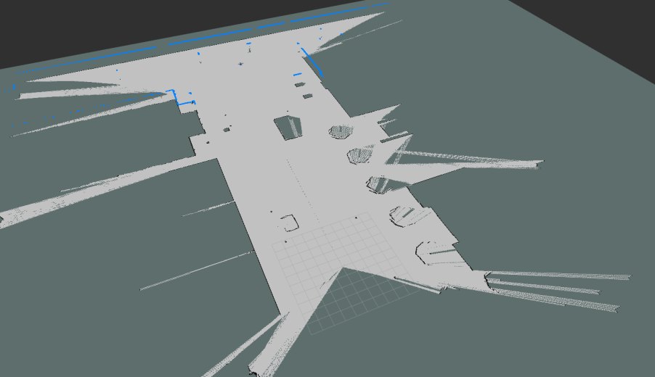
LIDAR AND SLAM
Velodyne hdl 32e
[8:50 AM]
SLAM
Simultaneous Localization and Mapping
Takes LIDAR as an input, provides a map and location
Types:
Scan Matching
Graph
LIDAR
Laser pulses in many directions to determine ranges
2D Lidar = Hokuyo utm30lx
3D Lidar = Velodyne hdl 32e

Slide 27
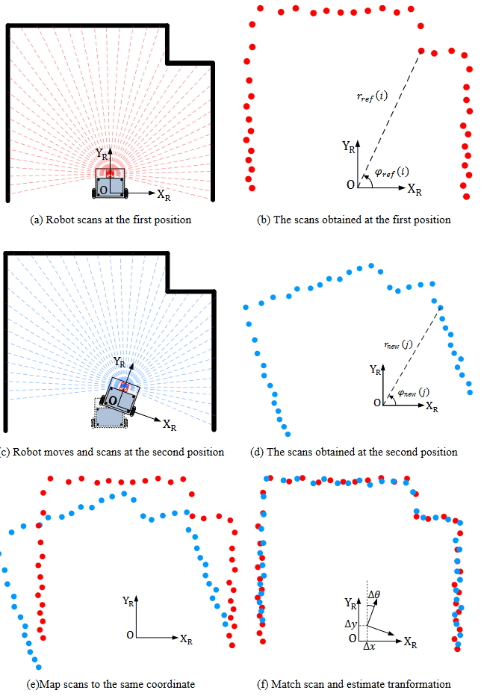
SCAN MATCHING SLAM
Estimates current pose such that it allows the most recent scan to best fit with the map within constraints on distance from previous pose in order to help with speed of computation.
Once pose is estimated, add information from new scan to the saved map.
Translating or rotating more quickly than the algorithm is configured to expect causes a scan match to fail.
Simpler implementation than graph SLAM and related methods which can modify even poses from the past with new scans’ information.

Slide 28
GRAPH SLAM
Robot starts at some pose x0.
Odometry provides an estimation of relative motion between time steps. These constitute relative motion constraints, and are treated as gaussian distributions centered on the iodometric estimation.
Laser scans allow the robot to find landmarks. The robot’s relative pose with those landmarks are also modeled as gaussian distributions centered on the sensor data estimation, and provide relative measurement constraints.
Sometimes the robot will come back to a position it has been in the past by a different route. By identifying the same landmarks in a different position, the robot can adjust past nodes on the graph to align old scans with the very high confidence measurement. This repairs gradually accumulated errors, performing what’s called a loop closure.
Graph SLAM combines all of these constraints as edges on a graph and the resulting estimation for the current pose is that which is most probable based on all of the past readings.

Slide 29
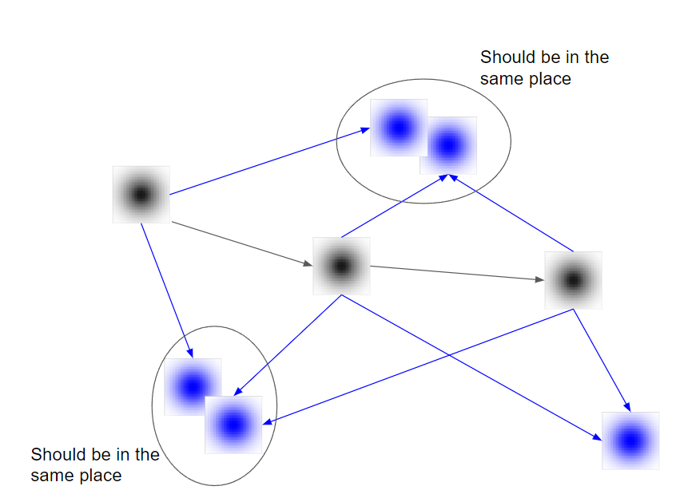
GRAPH SLAM
Gray:
Relative Motion
Constraints
Blue:
Relative Measurement
Constraints

Slide 30
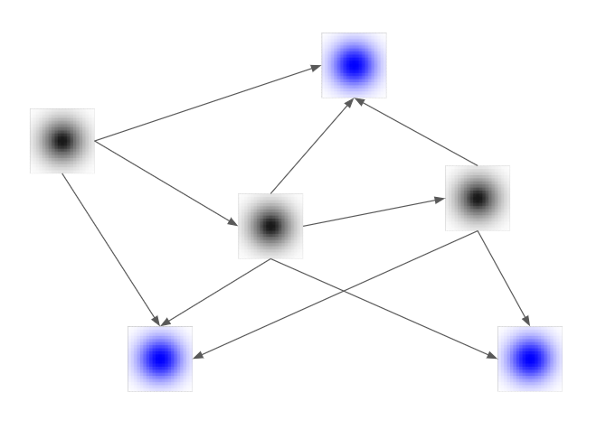
GRAPH SLAM
Pose Graph is adjusted to make the environment more consistent between scans. Balance between odometry and landmark constraints

Slide 31
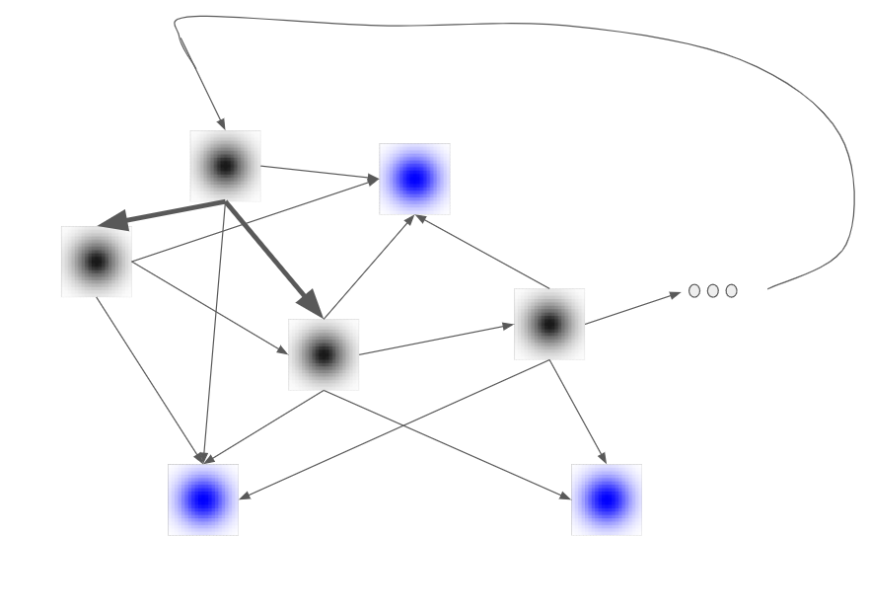
GRAPH SLAM
Relative motion constraints between non-consecutive nodes is a loop closure.

Slide 32
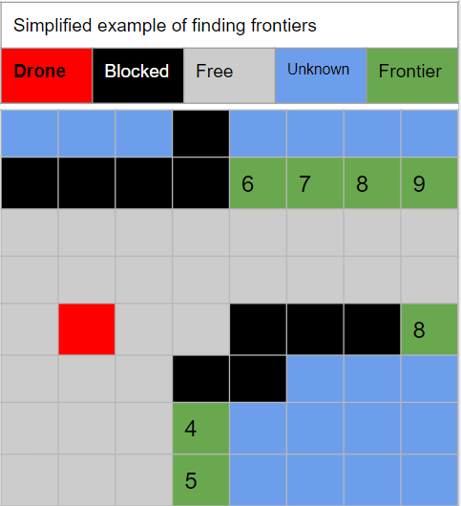
Finding
A Destination
Frontier
The edge of what hasn’t been seen yet
Finding frontiers
Breadth first search across the map provided by SLAM
Tracks distance from origin of the search at each position for prioritization of frontiers
Choosing a destination
Frontiers found are given costs based on distance
Take low cost frontier as the destination

Slide 33
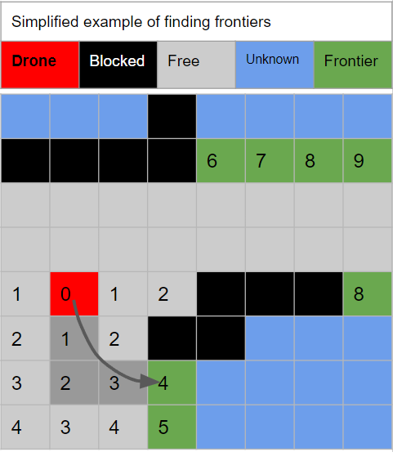
Choose
A Path
Determining the Path
Extract from the results of search for frontiers
Smooth the path
Command the motors to follow that path
Abstracted away by the Hector Quadrotor ROS package we are using for the drones

Slide 34
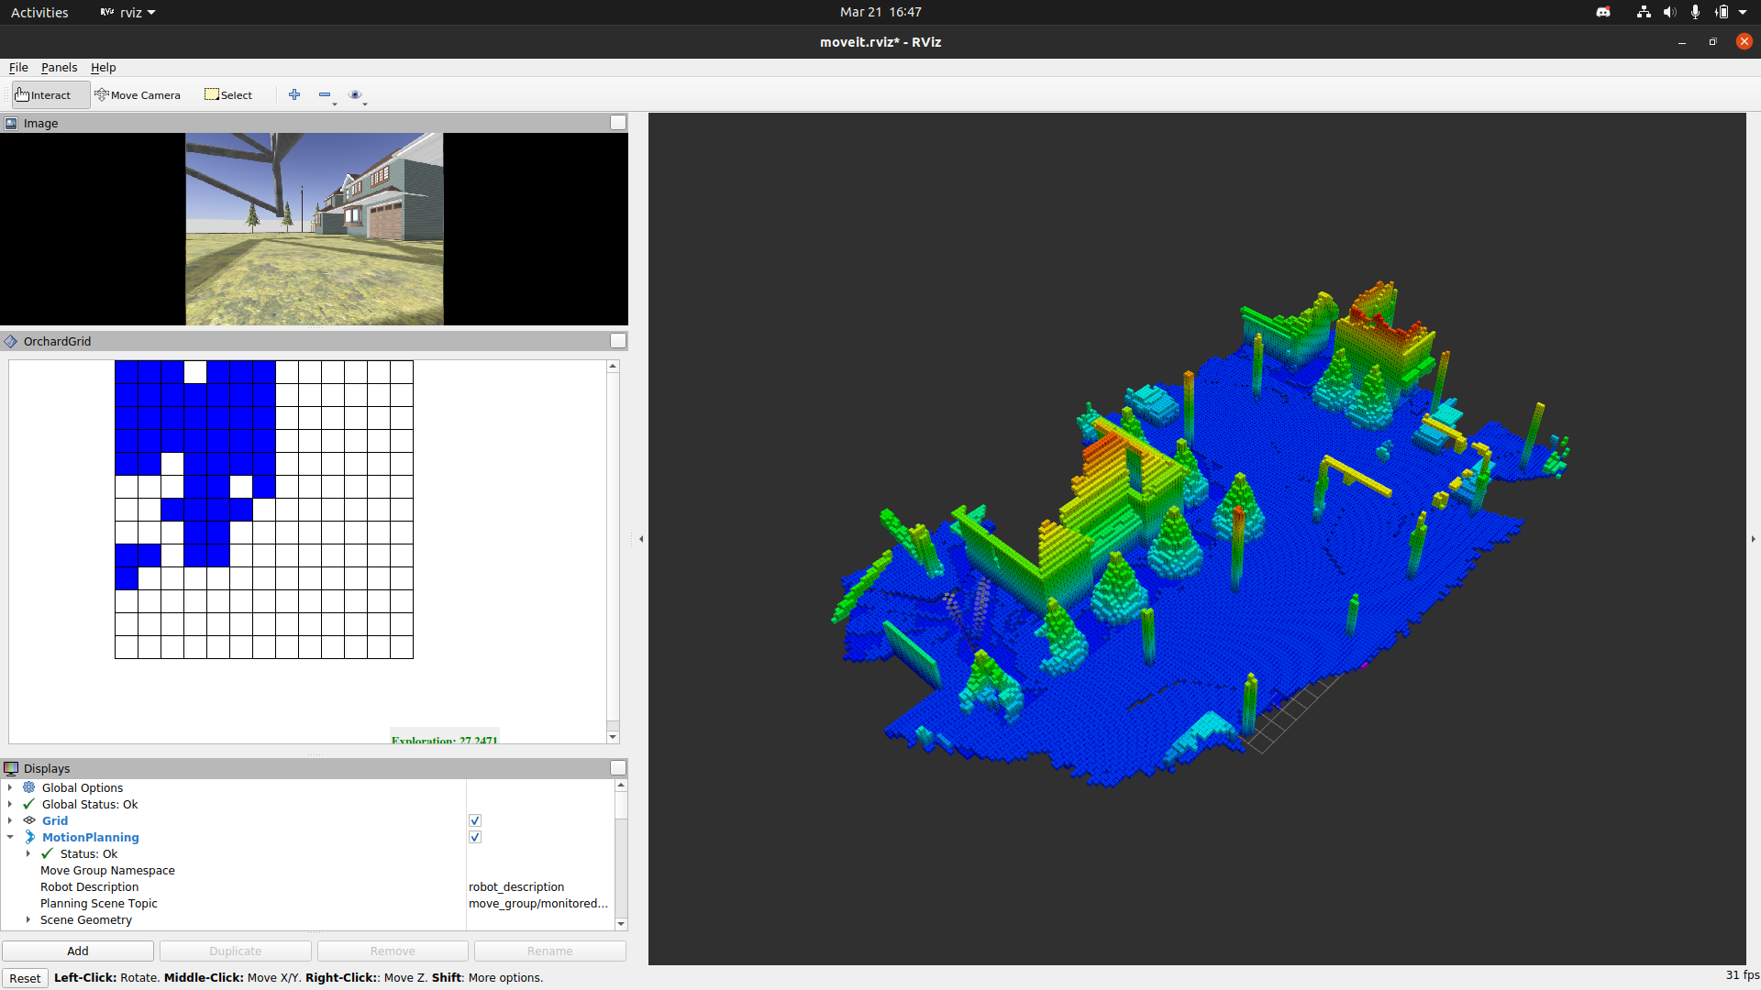
3D SLAM 3D PATHFINDING

Slide 35
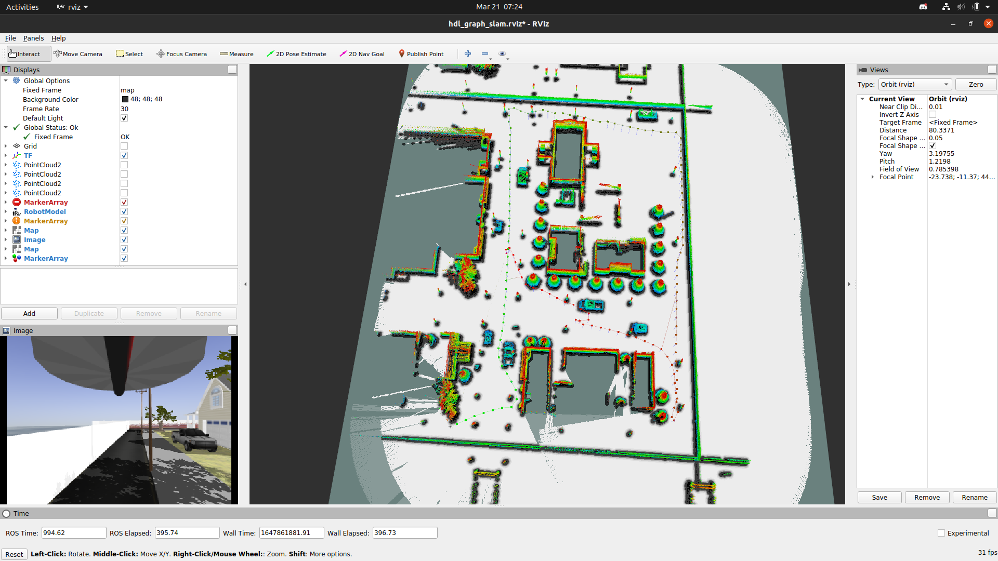
3D SLAM 2D PATHFINDING

Slide 36
MANAGING THREADING
Everything is a Process
At the end of the day, for everything we want in a single swarm implementation needs to run on a single simulation.
The computer needs to be able to handle the computation.
Independent YOLOv5 Models
3D Slam and Lidar
Having each drone run it’s own model was the plan, but that means multiple networks running on a single computer. Too many processes
Fine for one, Too much computation for a swarm
M = Drone count
N = Dimension of Map
Space Complexity = O(M x N³ )

Slide 37
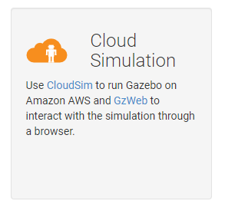
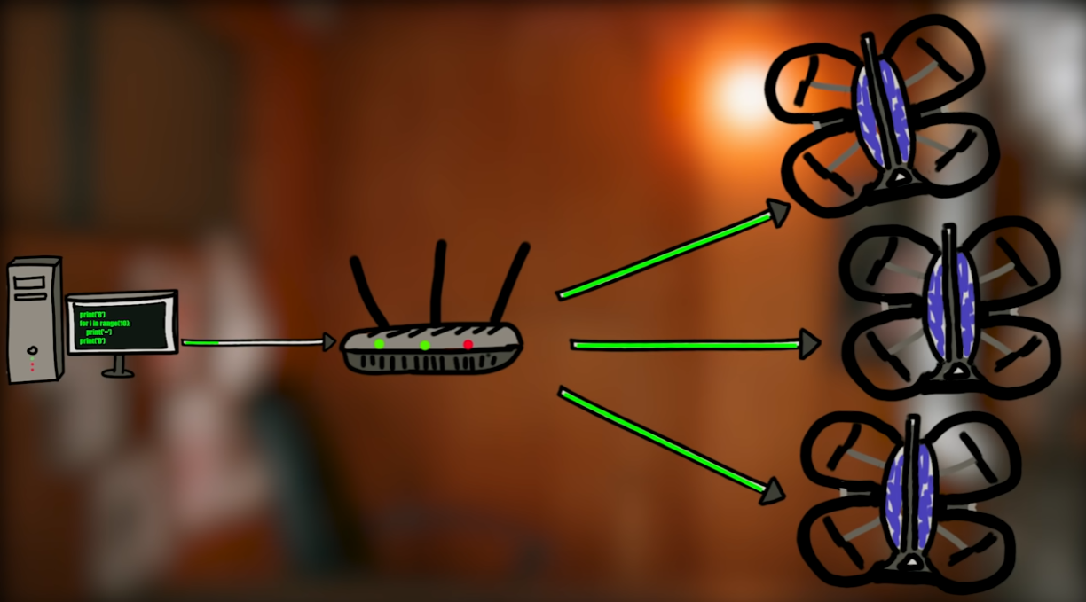
A SOLUTION, TOO LITTLE TOO LATE
The solution to our problem would have been to build on a deployed AWS server using Gazebo Web.
Unfortunately, we couldn’t have predicted our systems not being able to handle this and were unable to research this in time for a working deliverable
diagram by Youtuber “Michael Reeves” for real drones, same problem

Slide 38
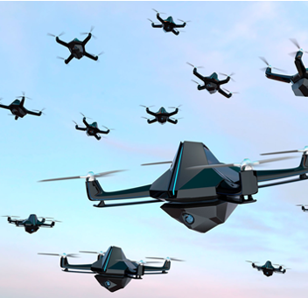
SWARM APPROACH
A swarm aspect to the search algorithm is novel to our project iteration.
The right approach is not a yes or no solution. Simply one is better than the other.
Thus, trial phases helped determine which one we use.

Slide 39
EXPLORATION ALGORITHM & PACKAGE
Explore-Lite
-Weighted combination of Size and Distance calculated for each frontier
-Greedily chooses from the frontiers
Decentralized so all robots running their own processes:
Initialize Navigation Stack On each Robot
Placed at different heights
Run Exploration Algorithm on each robot

Slide 40
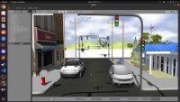
THE FINAL RESULT
Target found in: 2 minutes and 39 seconds
When target is found, the user is given display of an image with the detection. We have code that can be added to store images of when the target is found as well.
The group discussed what the end-case should be an decided on this as in a real world use: the drones shouldn't commit to a decision without human override. Drones continue to search regardless unless told to do otherwise by a human. Though, every time it finds a target the user is made aware.
That override result would be up to the user.

Slide 41

V3 CONSIDERATIONS
If we would have continued trials, here are some suggestions we would like to propose to test for implementations.
Search Patterns
Cluster/Ensemble Swarm
Particle Swarm Optimization
Reinforced Swarm

Slide 42
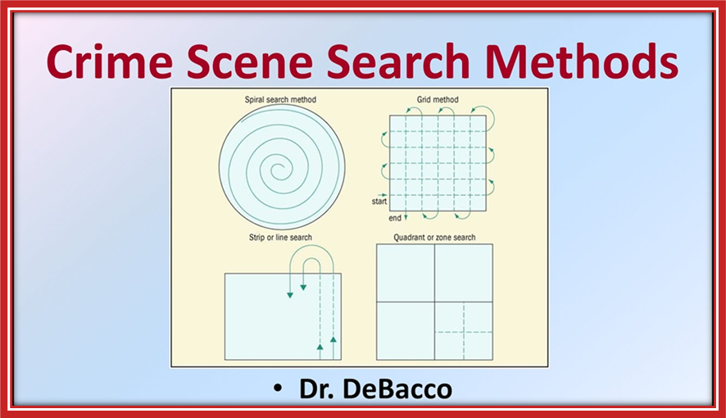
SEARCH PATTERNS
A Simple approach, waypoints are designated for the drones to navigate to, overall following a pattern.
Potential Patterns:
Lane
Spiral
Grid
Quadrant
Pros:
- Simple solution, a human approach
Cons:
- Not a very thorough search

Slide 43
CLUSTER/ENSEMBLE SWARM
A swarm of Clusters, where every cluster consists of 3 drones at different altitudes. Each drone in a cluster has their own YOLOv5 model (Different training sets). If a drone believes it has identified the target, the majority of that Cluster must verify and agree to be considered found.
Idea is based on Bagging method for ensemble learning.
Pros:
Severely decreased miscalculation rate
Quicker Search Time
Cons:
More Computation power
More Drones

Slide 44
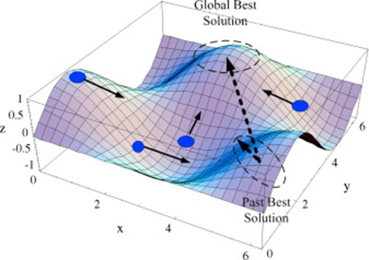
Particle Swarm Optimization
A swarm search algorithm using vector fields and candidate solutions to harness swarm collective knowledge.
Hyperparameters control how much each point uses its own knowledge versus the swarm's collective knowledge.
Pros:
- Shared knowledge
Cons:
- Complex Solution

Slide 45
REINFORCED SWARM
Logic for rewards and features would be dependent on the priority of the user. If the goal of our project remained the same in a future project, that main attribute would be time
Pros:
An adaptable and online solution
Cons:
- Complex solution (All elements of swarm implementation would be needing to be altered for optimization)

Slide 46
OUR BUDGET AND EXPENSES
$300 -
$45.47 =
$254.53
Provided by Lockheed Martin
for expenses
Gazebo/ROS courses
*1 Month Purchased*
Remainder​

Slide 47
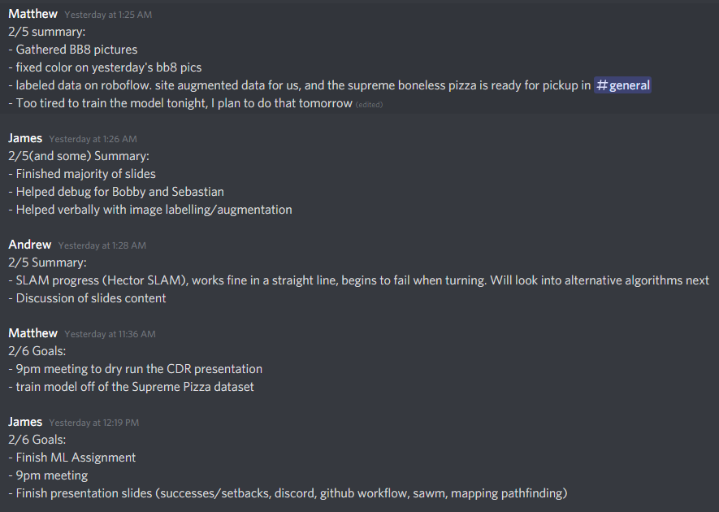
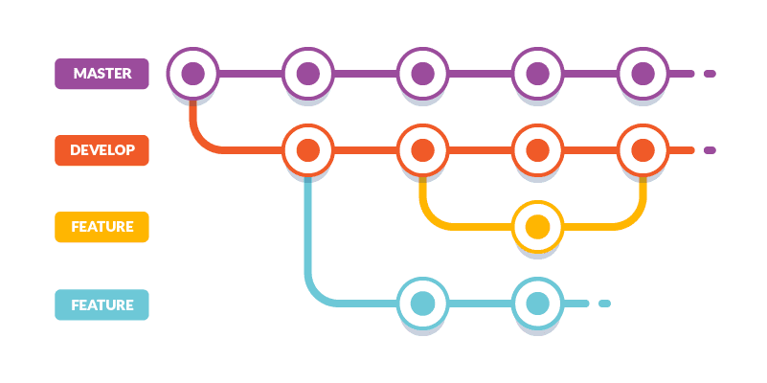
OUR GITFLOW
OUR Scrums

Slide 48
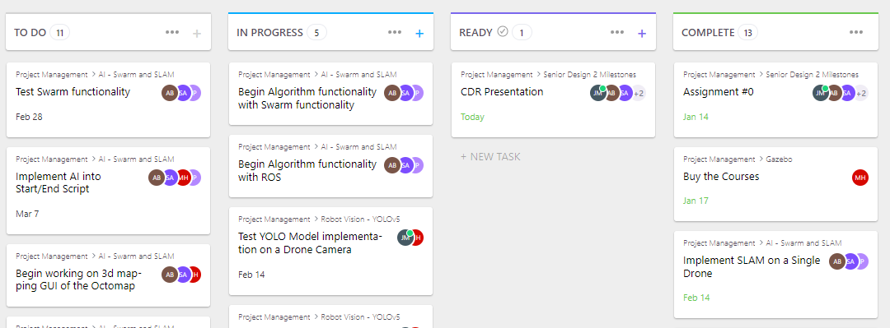
OUR

Slide 49
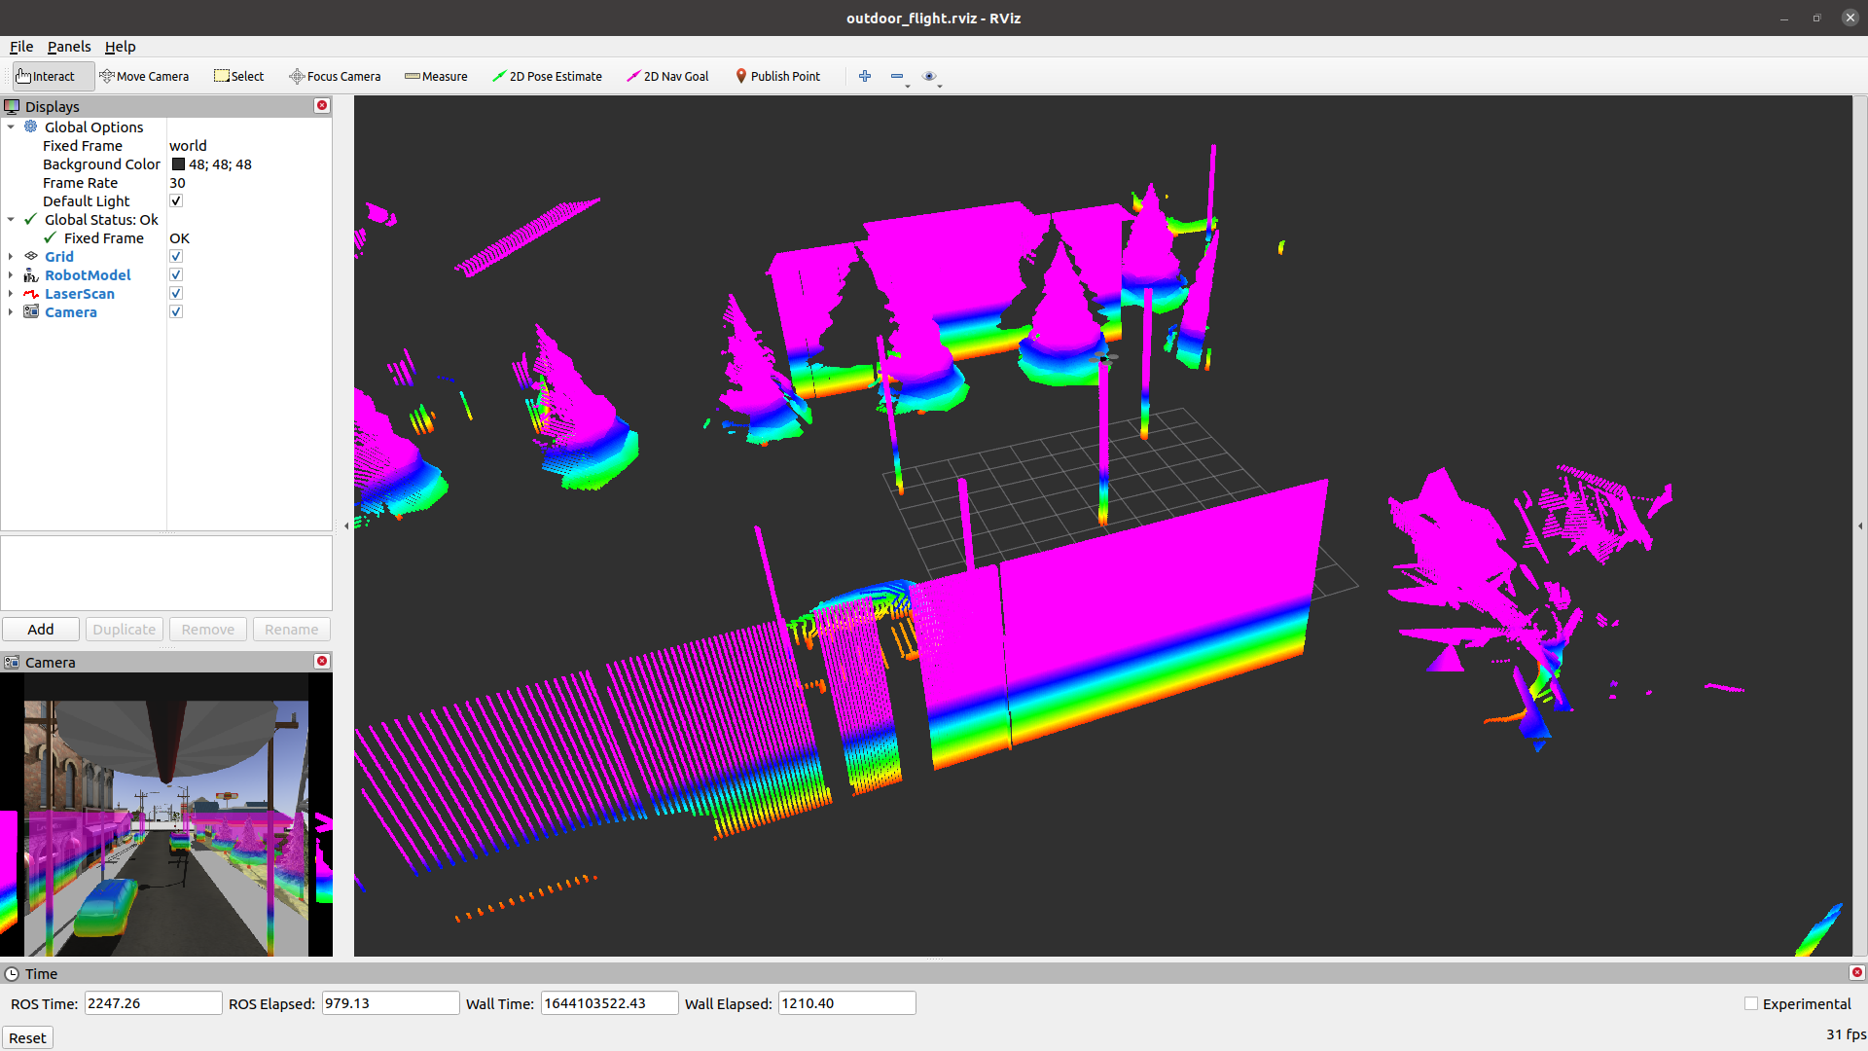
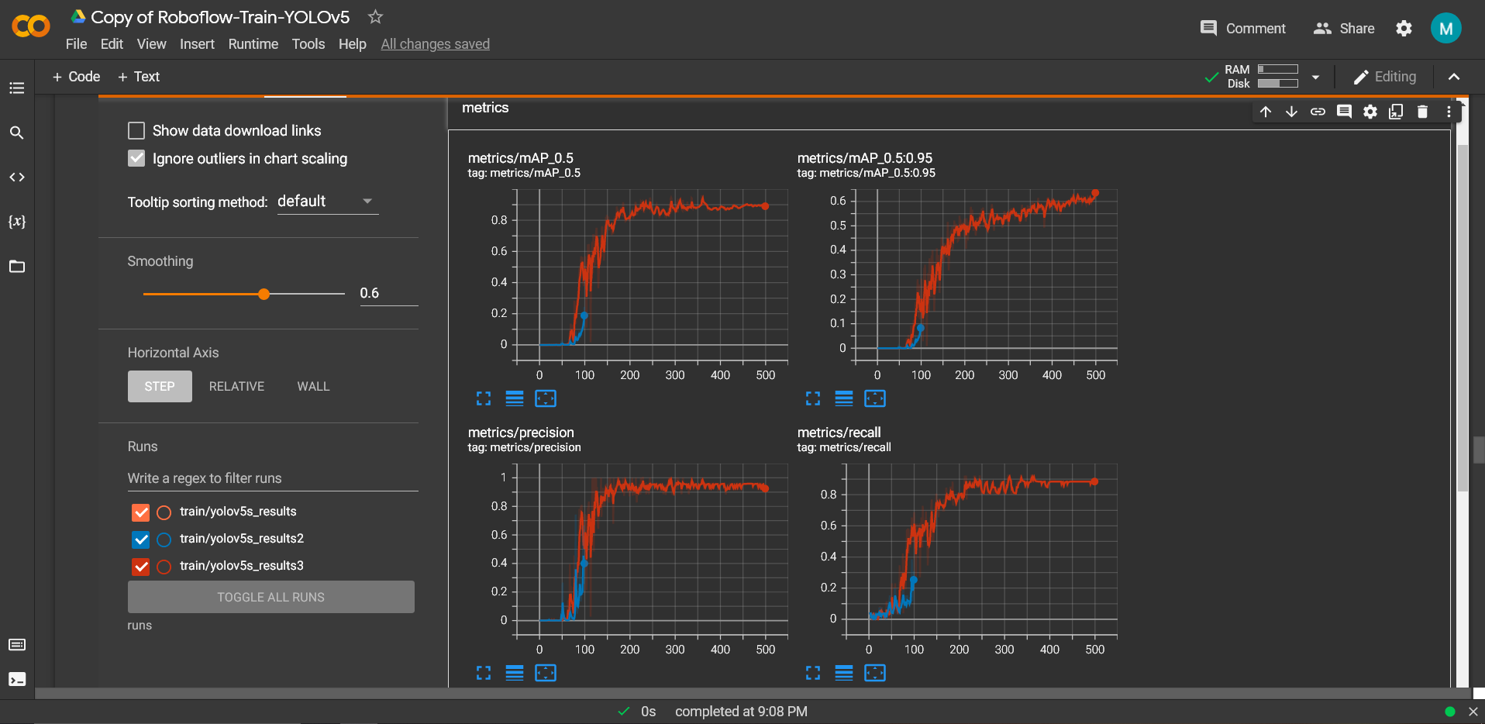
OUR SUCCESSES
Independent
There hasn’t been many issues with dependency due to our decision to split up the foundation-level tasks
Supportive
For whatever has occurred, we have been able to rebuild, debug, heal, or help each other recover as a group and move forward.
Diverse Skillset
Due to us all having various and unique knowledge in the field of CS, we have been able to be good resources for one another.
Major Milestones

Slide 50
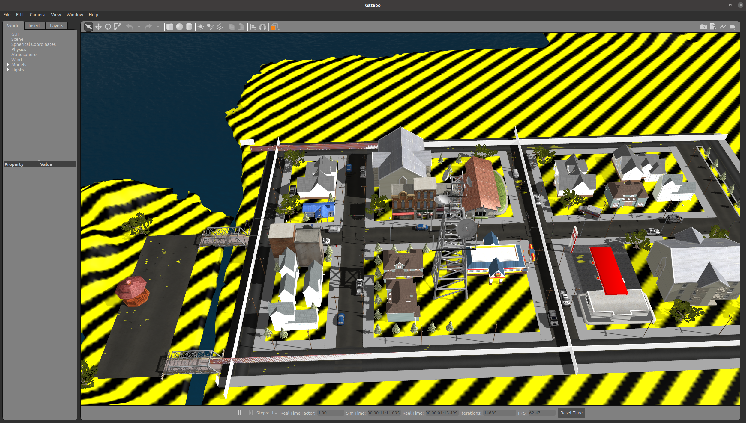
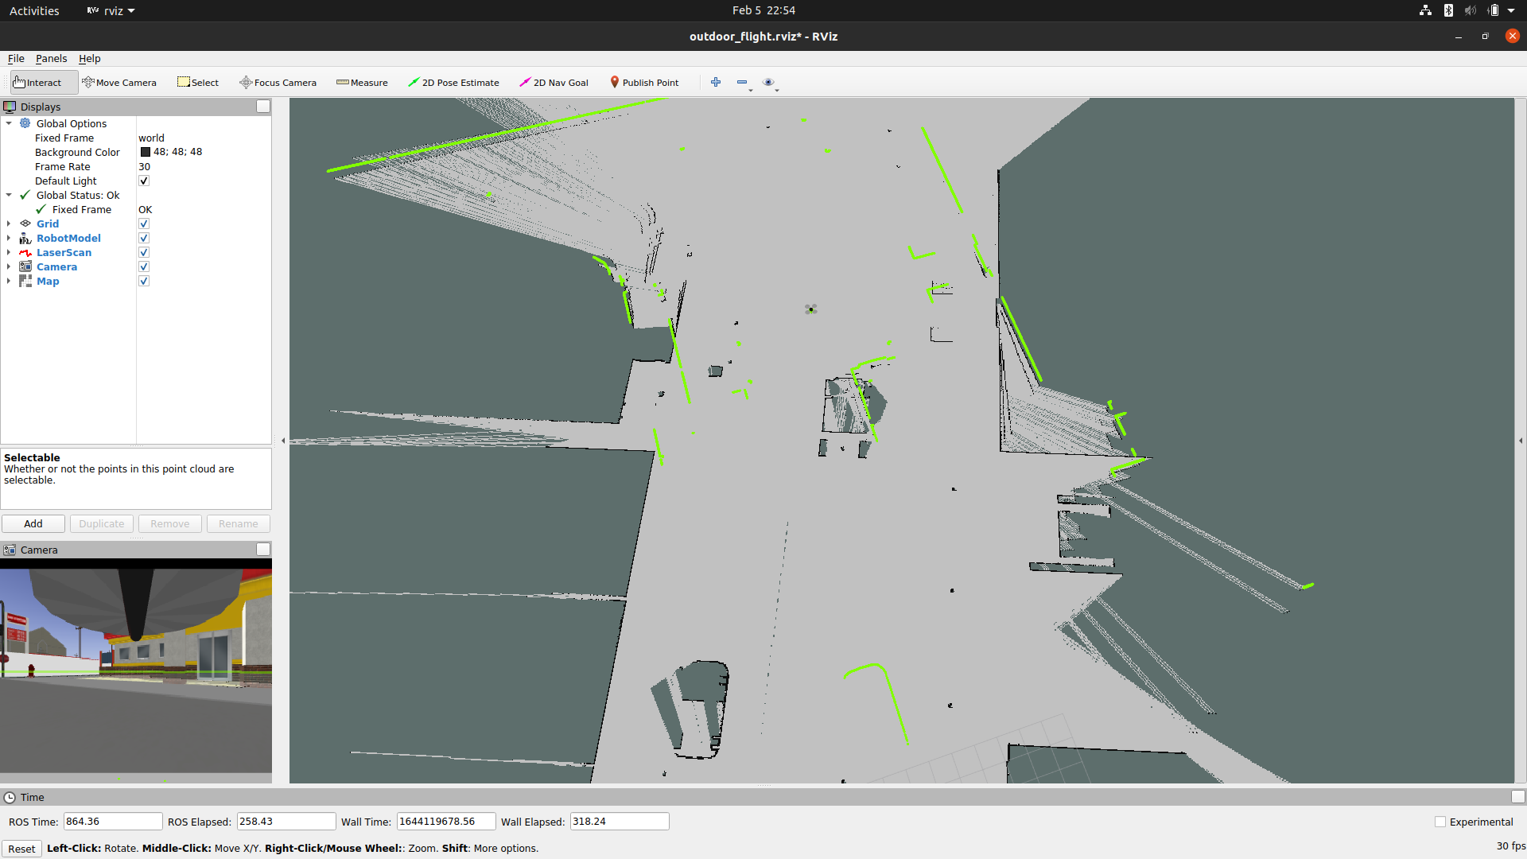
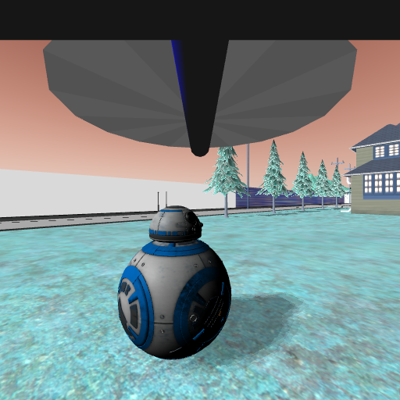
OUR SETBACKS
Building a simulation and robotics doesn’t work the same as a website. Finding the right way to assign tasks and deadlines has been difficult to get right.
Workflow
Communication
As the semester went on, it got harder to keep up with meetings as a full group, classes would build up and result in less activity.
Workspace Problems
Life
Sickness, Moving, other Assignments. Losing time to and progress due to these unavoidable obstacles.
Hardware Limitations
As discussed earlier, we sought to implement 3D Navigation but it was too intensive on our systems. Inevitably we lost some time due to needing to keep reverting back.

Slide 51
QUESTIONS
Thank You

